Slide 1
Attributes of good software?
The software should deliver the required functionality and performance to the user.
The various no of attributes associated with a software decides whether it is good or bad. These attributes reflect the quality of a software product.
The specific set of attributes which one expects from a software system depends on its application.
A banking system must be secure, a telephone system must be reliable, an interactive game must be responsive.
The general attributes of a good software are:

Slide 2
Attributes of good software?
Maintainability
Software must evolve to meet changing needs. This is a critical attribute coz software change is an inevitable consequence of a changing business environment.
Dependability
Software must be trustworthy. It has a range of sub attributes as reliability, security and safety. Dependable software should not cause physical or economical damage in the event of system failure.
Efficiency
Software should not make wasteful use of system resources such as memory, processor and storage. So it includes responsiveness, processing time, memory utilization.
Usability
Software becomes usable if it does not call for extra effort to be learnt. Usability increases with good documentation and an appropriate user interface.

Slide 3
Software Application Types:
System software (compilers, drivers)
Real time software
Business software (payroll, MIS)
Engineering and scientific software (simulation, CAD)
Embedded software
Personal computer software (word processing, multimedia, graphics, DBMS, entertainment)
Web based software
Artificial intelligence software (game playing, expert systems, pattern recognition)

Slide 4
Key challenges facing s/w eng.
The legacy challenge
The majority of larger software systems which are in use today were developed many years ago yet they perform critical business functions. The legacy challenge is the challenge of maintaining and updating this s/w in such a way that excessive costs are avoided and essential business services continue to be delivered.
The heterogeneity challenge
Systems are required to operate as distributed system across networks that include different types of computers and with different kinds of support system.
The delivery challenge
Many traditional software engineering techniques are time consuming. However, businesses today must be responsive and change very rapidly. The delivery challenge is the challenge of shortening delivery times for large and complex system without compromising quality.

Slide 5
Software engineering ethics/responsibilities
Software engineering involves wider responsibilities than simply the application of technical skills.
Software engineers must behave in an honest and ethically responsible way if they are to be respected as professionals.
Confidentiality
Engineers should normally respect the confidentiality of their employers or clients irrespective of whether or not a formal confidentiality agreement has been signed.

Slide 6
Software engineering ethics/responsibilities
Competence
Engineers should not misrepresent their level of competence. They should not knowingly accept work which is outwith their competence.
Intellectual property rights
Engineers should be aware of local laws governing the use of intellectual property such as patents, copyright, etc. They should be careful to ensure that the intellectual property of employers and clients is protected.
Computer misuse
Software engineers should not use their technical skills to misuse other people’s computers. Computer misuse ranges from relatively trivial (game playing on an employer’s machine, say) to extremely serious (dissemination of viruses).

Slide 7
Software life cycle
Is a series of identifiable stages that a software product undergoes during its life time.
A software product development effort usually starts with a feasibility study stage and then requirement specification, design, coding, testing and maintenance are undertaken.
Each of these stages is called a life cycle phase.
A software life cycle model is a descriptive and diagrammatic model of a software life cycle.
A life cycle model identifies all the activities required to develop and maintain the different activities
Several different activities are carried out in each life cycle phase.

Slide 8
Software life cycle
SDLCM graphically describes how development activities will be performed by depicting the sequence of the activities.
The sequence may or may not be linearly sequential because phase may follow one another, repeat themselves or run concurrently.
Advantage of SDLCM
It encourages the development of software in a systematic and disciplined manner.
When a program is developed by a single programmer, he has the freedom to decide the exact steps through which he will develop the program.

Slide 9
Software life cycle
However, when a product is being developed by a team, there must be precise understanding between the members as to when to do what otherwise it may lead to chaos and project failure.
SDLCM defines entry and exit criterion for every phase.
A phase is considered to be complete only if the corresponding phase exit criteria are satisfied.
Eg: phase exit criteria for specification phase can be SRS document.
With such well defined entry and exit criteria of various phases, it becomes easier for the software project managers to monitor the progress of the project.

Slide 10
Software life cycle
When a life cycle model is adhered to, the project manager can easily tell at which stage (design, coding, testing etc), the project currently is.
Cost of the while life cycle can be checked.
Communication between various parties improved.
Improvement and guarantee on the quality
If not life cycle model is adhered to, it becomes very difficult to chart the progress of the project and project manager would have to depend on the estimation of the team members.
This leads to a problem: 99% complete syndrome
When there is no definite way to assess the progress of a project, the optimistic team members fees that the project is 99% complete even when it is far from a completion.

Slide 11
Types of software process models :
Water Fall Model
Prototyping Model
RAD Model
Evolutionary Model
Incremental Model
Spiral Model
Win-Win Spiral Model
Concurrent Development Model
Component Based Development

Slide 12
Water fall model
It is also referred to as a linear-sequential life cycle model
It is very simple to understand and use.
In a waterfall model, each phase must be completed fully before the next phase can begin.
At the end of each phase, a review takes place to determine if the project is on the right path and whether or not to continue or discard the project
In waterfall model phases do not overlap.

Slide 13
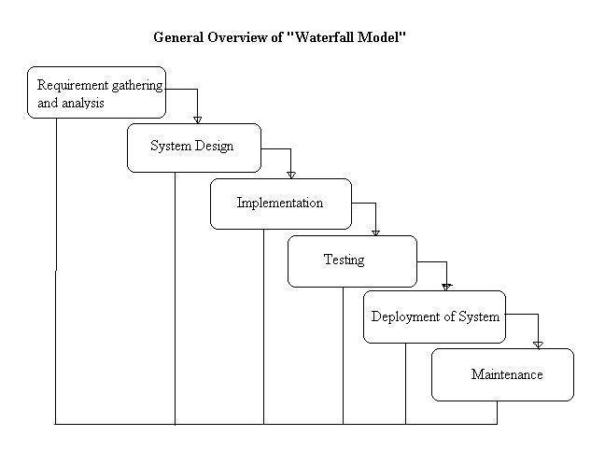
Water fall model

Slide 14
Waterfall Model Phases
Requirements
Feasibility study (technical, financial)
Aim: to understand the exact requirements of the customer and document them properly
Requirement analysis + req. specification
Requirement analysis
Requirement analysis starts with the collection of all relevant data regarding the product from users through interviews and discussion.
Eg: for accounting software, interview all accounts of the organization
Data collected from a group of users usually contain several contradictions and ambiguities coz each user has its own view of system.
After all ambiguities, inconsistencies are resolved and all the requirement are properly understood, requirements are organized into SRS documents.

Slide 15
Waterfall Model Phases
Requirement specification
User requirements are properly organized and documented in a SRS document.
SRS document address the functional, non-functional and special requirements
SRS document serves as a contract between the development team and customer.
So it is important document which must be thoroughly understood by all the developers and periodically reviewed jointly with the customer
SRS document: functional requirement, constraints, input , output, required standards etc

Slide 16
Waterfall Model Phases
Design
Design phase translates the SRS into the design document which depicts the overall modular structure of the program and interaction between these modules.
In technical term, through design phase we derive the software architecture from SRS document.
Two design strategies: traditional and object oriented designs

Slide 17
Waterfall Model Phases
Implementation and unit testing
The purpose of this phase is to translate the software design into source code.
During this, each component of the design is implemented as a program module, and each of the program module is unit tested, debugged and documented.
The purpose of unit testing is to determine the correct working of the individual modules.
Unit testing involves precise test cases, testing criteria
End product is program modules tested

Slide 18
Waterfall Model Phases
Integration and system testing
Different modules are integrated in a planned manner
Integration doesn’t happen in a single shot
During each integration step, the partially integrated system is tested.
Finally when all modules have been successfully integrated and tested, system testing is carried out.
Goal of testing is to ensure that the developed system functions according to the requirements in SRS document.
It includes alpha, beta testing.
Output of testing is the TEST REPORT

Slide 19
Waterfall Model Phases
Deployment and maintanance
Corrective maintenance
correcting errors not discovered during development phase
Perfective maintenance
improving the implementation and enhancing the functionalities of the system as per customer’s requirements
Adaptive maintenance
porting the software to a new environment eg. To a new computer or to a new OS.

Slide 20
Water fall-advantages
Simple and easy to understand and use
Each phase has well defined inputs and outputs.
Easy to manage due to the rigidity of the model – each phase has specific deliverables
Phases are processed and completed one at a time.
Works well for smaller projects where requirements are very well understood

Slide 21
Water fall-disadvantages
This model is just like a one way street. Once the phase X is complete and next phase Y has started, then there is no provision of going back.
Users have little interaction with the project team. Their feedback is not taken during development.
Not a good model for complex projects
Not suitable where requirements are at very high risk of changing

Slide 22
Water fall-when to use
Requirements are very well known, clear and fixed.
There are no ambiguous requirements
The project is short

Slide 23
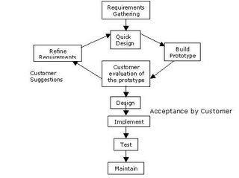
Prototyping Model

Slide 24
Prototyping model
The prototype model suggests that before developing the actual software, a working prototype of the system should be built.
A prototype is a partially developed product.
It has limited functional capabilities, low reliability and inefficient performance.
Model starts with an initial requirement gathering.
A quick design is carried out and the prototype is built using several shortcuts.
The shortcuts might involve using inefficient, inaccurate or dummy functions
Eg: a function might produce the desired result by using a table look-up rather than performing actual computation.

Slide 25
Prototyping model
The developed prototype is submitted to the customer for his evaluation.
Based on user feedback, the requirements are refined.
This cycle continues until the user approves the prototype.
The actual system is then developed using the classical waterfall model.
Not suitable for final software product.
The code for the prototype is thrown away, however the experience gathered from developing the prototype helps in developing the actual system.
So the development of a prototype might involve extra cost, but overall cost might turn out to be lower than that of an equivalent system developed using waterfall model.

Slide 26
Prototyping model-advantages
A partial product built is built in the initial stages, so, customers get a chance to see the product early in the life cycle and gives a necessary feedback.
Requirements become more clear resulting into an accurate product.
New requirements can be easily accommodated, as there is a scope for refinement.
As user is involved from the starting of the project, he tends to be more secure, comfortable and satisfied.

Slide 27
Prototyping model-disadvantages
Developers in a hurry may build prototypes and end up with sub-optimal solutions.
After seeing an early prototype, the users may demand the actual system to be delivered soon.
End users may not like to know the difference between a prototype and a well engineered fully developed system
If not managed properly, the interactive process of prototype demonstration and refinement can continue for long duration
If end user is not satisfied with initial prototype, he may loose interest in the project.

Slide 28
Prototyping model-when to use
Prototype model should be used when the desired system needs to have a lot of interaction with the end users.
Typically, online systems, web interfaces have a very high amount of interaction with end users, are best suited for Prototype model. It might take a while for a system to be built that allows ease of use and needs minimal training for the end user.
Prototyping ensures that the end users constantly work with the system and provide a feedback which is incorporated in the prototype to result in a useable system. They are excellent for designing good human computer interface systems.

Slide 29
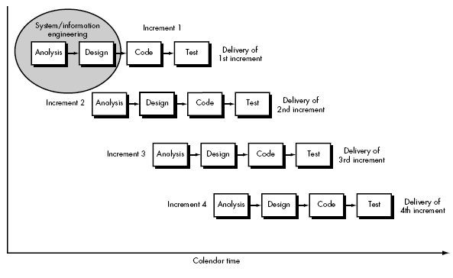
Incremental Model

Slide 30
Incremental Model
When the elements of waterfall model are applied in iterative manner, the result is the Incremental Model
The product is designed, implemented, integrated and tested as a series of incremental builds
This model is more applicable where software requirements are well defined and basic software functionality is required early.
In incremental model, a series of releases called 'increments' are delivered that provide more functionality progressively for customer as each increment is delivered..
The first increment is known as core product. This core product is used by customers and a plan is developed for next increment and modifications are made to meet the needs of the customer. The process continues till the complete system is achieved.

Slide 31

Incremental model-an analogy

Slide 32
Incremental- advantages
Generates working software quickly and early during the software life cycle.
More flexible – less costly to change scope and requirements.
Easier to test and debug during a smaller iteration.
Customer can respond to each built.
Lowers initial delivery cost.
Easier to manage risk because risky pieces are identified and handled during it’d iteration.

Slide 33
Incremental- disadvantages
Needs good planning and design.
Needs a clear and complete definition of the whole system before it can be broken down and built incrementally.
Total cost is higher than waterfall.

Slide 34
Incremental-when to use
Requirements of the complete system are clearly defined and understood.
Major requirements must be defined; however, some details can evolve with time.
There is a need to get a product to the market early.
A new technology is being used
Resources with needed skill set are not available

Slide 35
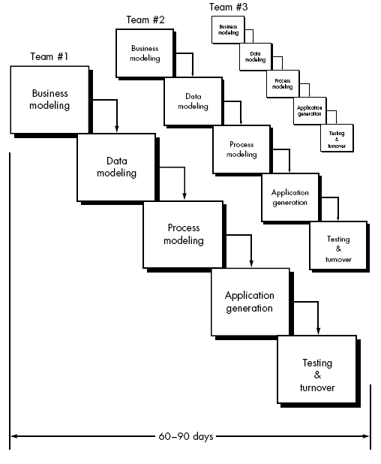
RAD model

Slide 36
RAD model
Rapid application development (RAD) is an incremental software development process model that emphasizes an extremely short development cycle
The RAD model is a “high-speed” adaptation of the linear sequential model in which rapid development is achieved by using component-based construction.
If requirements are well understood and project scope is constrained, the RAD process enables a development team to create a “fully functional system” within very short time periods (e.g., 60 to 90 days)

Slide 37
RAD model-phases
Business modeling. The information flow among business functions is modeled in a way that answers the following questions:
What information drives the business process?
What information is generated?
Who generates it?
Where does the information go? Who processes it?

Slide 38
RAD model-phases
Data modeling. The information flow defined as part of the business modeling phase is refined into a set of data objects that are needed to support the business. The characteristics (called attributes) of each object are identified and the relationships between these objects defined.
Process modeling. The data objects defined in the data modeling phase are transformed to achieve the information flow necessary to implement a business function. Processing descriptions are created for adding, modifying, deleting, or retrieving a data object.

Slide 39
RAD model-phases
Application generation. RAD assumes the use of fourth generation techniques.
Rather than creating software using conventional third generation programming languages, the RAD process works to reuse existing program components (when possible) or create reusable components (when necessary).
In all cases, automated tools are used to facilitate construction of the software.

Slide 40
RAD model-phases
Testing and turnover. Since the RAD process emphasizes reuse, many of the program components have already been tested. This reduces overall testing time.
However, new components must be tested and all interfaces must be fully exercised.
Model. Obviously, the time constraints imposed on a RAD project demand “scalable scope” .
If a business application can be modularized in a way that enables each major function to be Completed in less than three months (using the approach described previously), it is a candidate for RAD.
Each major function can be addressed by a separate RAD team and then integrated to form a whole.
Eg: CMS, VISUAL STUDIO

Slide 41
RAD model-advantages
Reduced development time.
Increases reusability of components
Quick initial reviews occur
Encourages customer feedback
Integration from very beginning solves a lot of integration issues.

Slide 42
RAD model-disadvantages
Depends on strong team and individual performances for identifying business requirements.
Only system that can be modularized can be built using RAD
Requires highly skilled developers/designers.
High dependency on modeling skills
Inapplicable to cheaper projects as cost of modeling and automated code generation is very high.

Slide 43
RAD model-when to use
RAD should be used when there is a need to create a system that can be modularized in 2-3 months of time.
It should be used if there’s high availability of designers for modeling and the budget is high enough to afford their cost along with the cost of automated code generating tools.
RAD SDLC model should be chosen only if resources with high business knowledge are available and there is a need to produce the system in a short span of time (2-3 months).

Slide 44
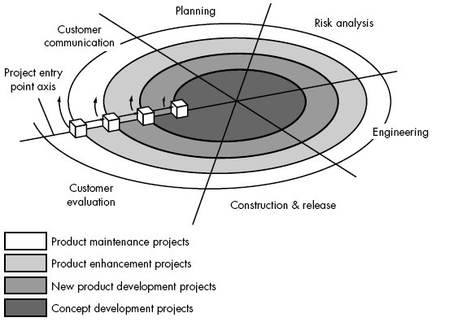

Slide 45
Spiral Model (Proposed by Bohem)
This evolutionary software process model combines the iterative nature of prototyping model , the control and systematic aspect of linear sequential model
It has potential for rapid development of incremental versions of the software
Software is developed in a series of incremental releases
Early stage increments: paper model or prototype
Subsequent stage releases: more complete version of required software

Slide 46
Spiral Model is divided into a number of Frame Work Activities or Task Regions .
There are six task regions or frame work activities:
Customer Communication: Task for effective communication between customer and developer
ii. Planning : Task is to define resources, timeline and other project related information
iii. Risk analysis: the task is to assess technical and management risks
iv. Engineering: task required to build one or more representations of the application

Slide 47
Construction and release: task to construct, test, install and provide support (documentation, training etc)
Customer evaluation: task is to obtain customer feedback or evaluation (engineering stage versus implementation stage)
Spiral model handles the software development process in phase manner, each phase being treated as a project work
Spiral model divides the development process into four projects:

Slide 48
Each region is populated by a series of tasks specific to the nature of the project
In all cases , umbrella activities are applied (SCM and SQA)
All the stages iterative in nature:
First Iteration: Results in production of product specification
Second Iteration: Results in production of product prototype
Next Iteration: Results in production of progressively more sophisticated versions of the software

Slide 49
Each pass thru the planning region two results in adjustment to the project plan
Cost and schedule adjusted on the basis of customer evaluation
Project manager adjusts the number of iterations to complete the software
Classical model ends when the software is delivered. Spiral model can be applied thru out the life of the software
Each project in the Spiral model has a starting point in the project entry point axis, which represents the start of a different type of project
Spiral model remains active until the software retires

Slide 50
Spiral model is a realistic approach to development of large scale projects
Spiral model uses Prototyping as a Risk Reduction mechanism. Prototyping is applied at any stage of the product
It incorporated systematic approach as suggested by classical life cycle of software in an iterative way (frame-work)
It demands direct consideration of technical risk
Discussions:
Difficult to convince customer that evolutionary approach is controllable
High expertise is required to assess considerable risk
This is a new model not used widely as linear sequential development approach
It will take number of years before the effectiveness of this model is known

Slide 51
Spiral-advantages
High amount of risk analysis hence, avoidance of Risk is enhanced.
Good for large and mission-critical projects.
Strong approval and documentation control.
Additional Functionality can be added at a later date.
Software is produced early in the software life cycle.

Slide 52
Spiral-disadvantage
Can be a costly model to use.
Risk analysis requires highly specific expertise.
Project’s success is highly dependent on the risk analysis phase.
Doesn’t work well for smaller projects as the cost of risk analysis may exceed the actual cost of the project.
The large no of intermediate stages can create additional internal and external documentation to process.

Slide 53
Spiral-when to use
When costs and risk evaluation is important
For medium to high-risk projects
Long-term project commitment unwise because of potential changes to economic priorities
Users are unsure of their needs
Requirements are complex
New product line
Significant changes are expected (research and exploration)

Slide 54
Win-Win Spiral Model
Spiral model suggests customer communication to decide upon project requirements form customer
Developer asks what is required and customer provides necessary details
In reality, developer negotiates with customer for functionality , performance, and other product /system features against cost and time to market
Negotiation is successful at Win-Win state:
Customer wins by getting a product /system that satisfies majority of his requirements
Developer wins by deadline target and achievable budget

Slide 55
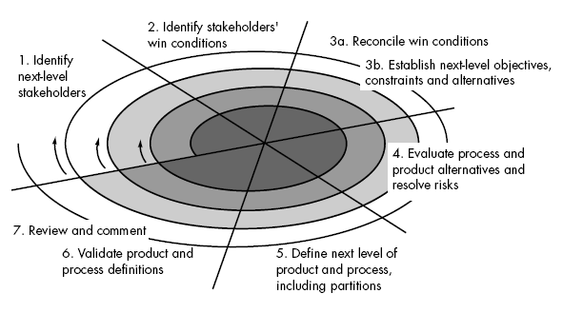

Slide 56
Negotiation takes place at the beginning of each pass around the spiral , involving the following activities:
Identification of the key stake holders of the system/sub systems
Determination of the stake holder’s win condition
Negotiation of the stake holder’s win condition to fit into a set of Win-Win conditions
for all concerned (including software development project team)

